Slide 1
Numpy
Tutorials and Concepts

Slide 2
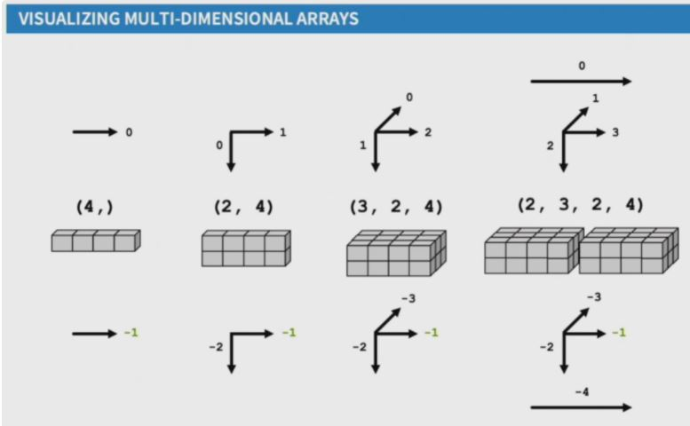
Numpy axis for 1D,2D and >3D

Slide 3
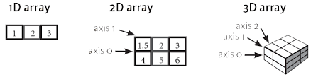
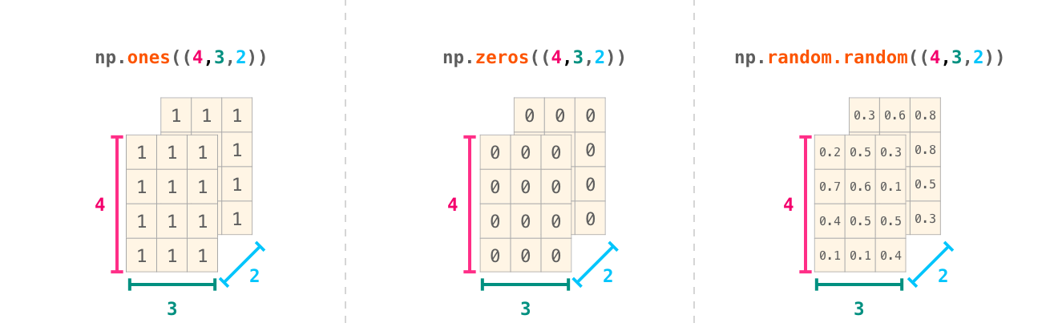
Numpy shape for 3d arrays

Slide 4
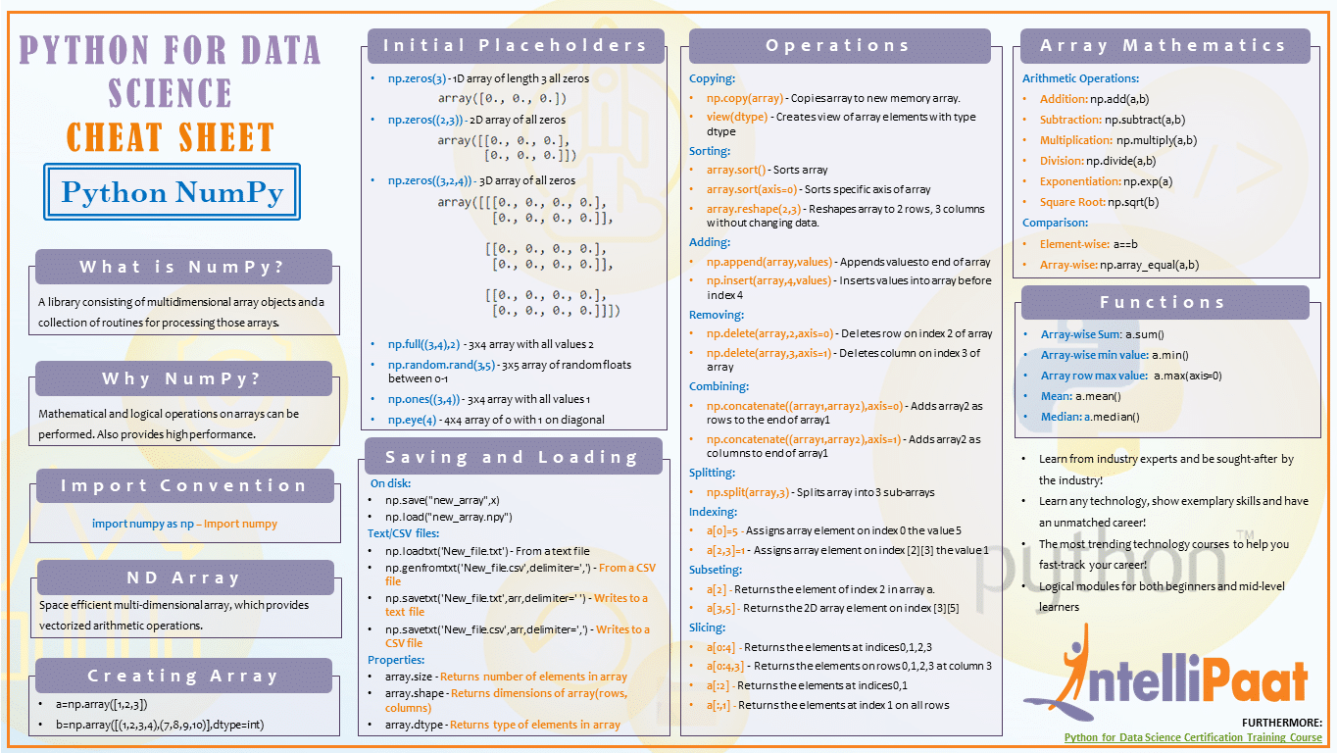
Numpy cheatsheet

Slide 5
